Slide 1

Linked List
Data Structures
Dr. Bouchaib Falah

Slide 2
List Overview
Linked lists
Abstract data type (ADT)
Basic operations of linked lists
Insert, delete, search, print, traversal, etc.
Variations of linked lists
Linear linked lists (Simply)
Circular linked lists
Doubly linked lists

Slide 3
Why Linked Lists?
Why linked lists?
To overcome the drawbacks of arrays
mainly:
Inserting (An element is always added to the end of the array)
Deleting (if element is deleted, its place is still there)
Memory Space
Optimal memory use is sustained by dynamic allocation
Allocate space as needed
Can insert/remove easily anywhere in a LL

Slide 4

What is a Linked list? How Does it look like?
What is a linked list?
A chain of structures -Nodes- linked one to another through pointers
The link in each node, except the last, points to its successor.
The link in last node contains a NULL pointer, indicating the end of the list.
Head is a pointer to the first element in the list
Notes:
The figure above shows a linked list containing four nodes.

Slide 5
Nodes / Linked lists Definitions
The elements of a linked list are called “Nodes”
Each element/node contains the location of the next element: “Linkage”
A node is a structure that has two parts:
Data & Link
The data part holds the useful information
The link is a pointer holding the address of the next element  A pointer to the same data type

Slide 6
Creating a LinkedList
// Definition of struct node
struct node {
char info[20];
struct node *next;
};
// Declare variable head of type pointer to struct node
struct node *head;
// To indicate that list is empty
struct node *head= NULL;
/* Request a chunk of memory of the right size for struct node */
head = (struct node *) malloc ( sizeof (struct node ) );

Slide 7
Nodes_Example
You always need to “dynamically” create Nodes  A node always contains a pointer to the same Node data type.
Example:
typedef struct stud {
char name[20];
double gpa;
struct stud *next;
}stud_n;
stud_n *head;
head = (stud_n *) malloc(sizeof(stud_n))
Data
Link

Slide 8
Pointers to linked lists Why a head pointer?
With arrays, we know where the list begins: The successor to each element is simply the next element in the array.
But, in a linked list, there is no physical relationship between nodes.
Without this physical relationship, we need a way to distinguish/point the beginning of the list. This pointer is known as the Head pointer because it points to the node at the head of the list.

Slide 9
Creating a LL by Appending
Analogy Appending data at the end of a text file
First step: Create the head pointer
Second: Create the first node and insert it by simply attaching it to head.
To add a second node, append it by attaching it to the first node
To add a third node, append it by attaching it to the second node.
You continue appending nodes in this way till you have placed all the data in your linked list.

Slide 10
Basic linked list operations
Insertion:
At the beginning (Easiest)
At the end (Harder)
At the middle (Hardest)
Deletion
At the beginning (Easiest)
At the end (Harder)
At the middle (Hardest)
Search
Traversal
Print

Slide 11
Preliminaries

Slide 12
Inserting a Node
Algorithm (Four steps):
1. Allocate memory for the new node
2. Determine the insertion point:
That is the position within the list where the new data are to be placed.
To identify the insertion position, you need to know only the new node’s logical predecessor
3. Point the new node to its successor
4. Point the predecessor to the new node

Slide 13
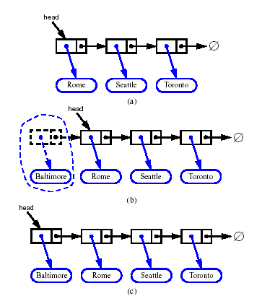
Inserting at the Beginning
Allocate a memory for the new node
Insert new element
Make new node point to old head
Update head to point to new node

Slide 14
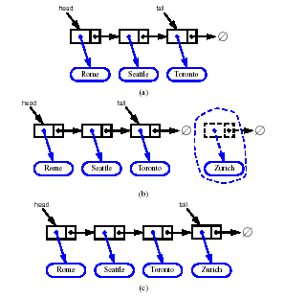
Inserting at the End
Allocate a memory for the new node
Insert new element
Have new node point to null
Have old last node point to new node

Slide 15
Inserting at the Beginning of a LL
To add a new node to a linked list, it is easiest and fastest to insert the node at the head (at the start)
Node *head = NULL;// a global variable here
void InsertAtFirstNode (Node *new_node){
new_node->next = head;
head = new_node;
}
NOTE:
Before inserting a node, we must create it.

Slide 16
Deleting at the Beginning of a LL
To delete the first node from a linked list:
Move the head to the next node
Return the deleted node
Node *DeleteFirstNode( ) {
Node *deleted_node = head;
head = head->next;
return deleted_node;
}
NOTE: head is a global variable here

Slide 17
Printing a List
void PrintList ( Node *list ) {
while ( list!= NULL ) {
puts (list->info); // Prints info
list = list->next;
}
}

Slide 18
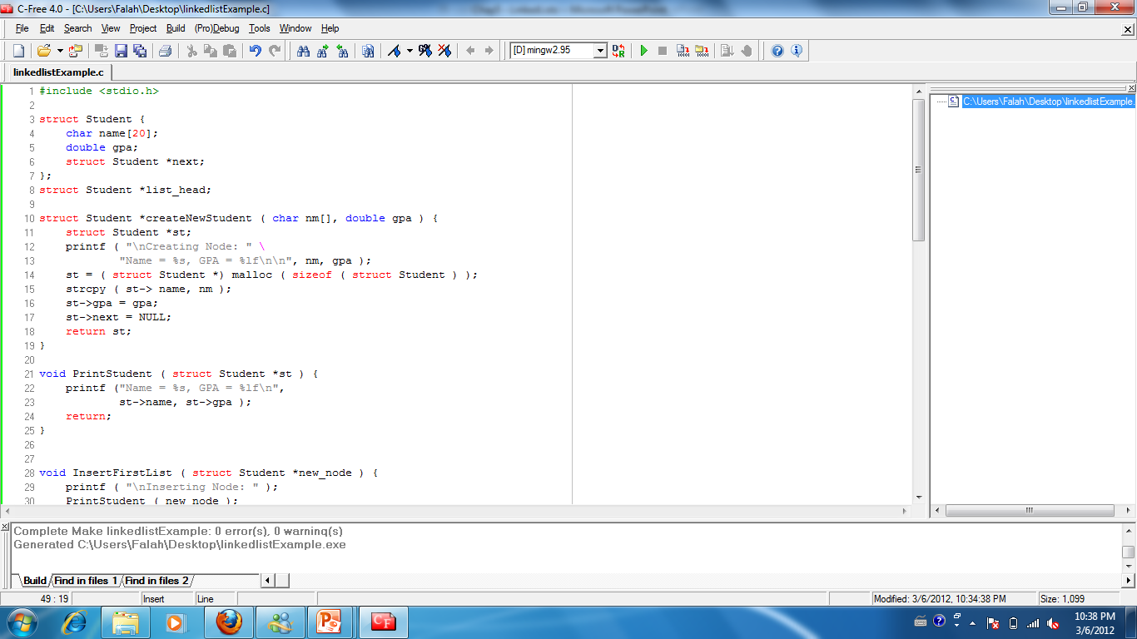
Example: Inserting and Deleting at the beginning of LL
Define a student struct Node and declare a list head

Slide 19
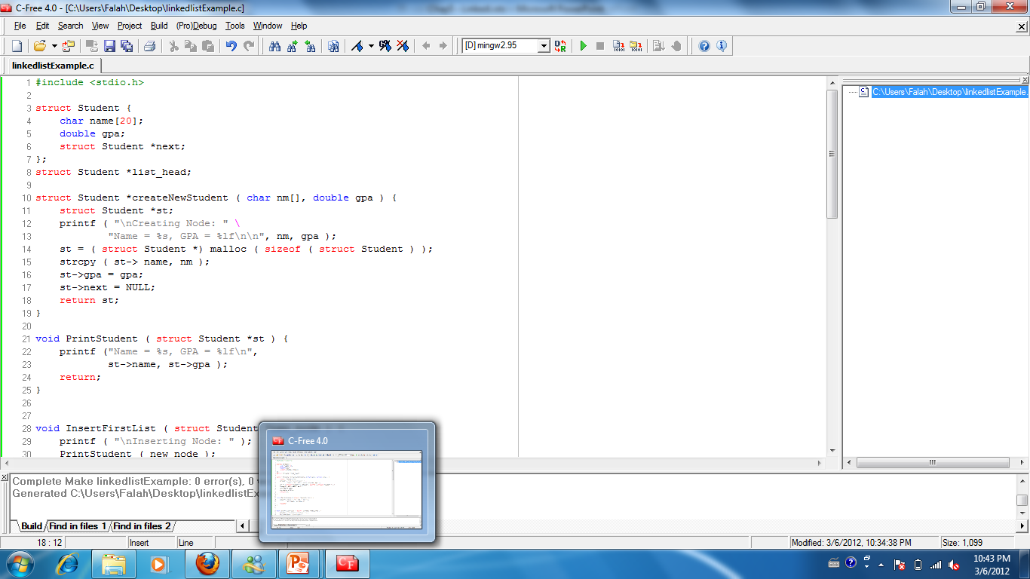
Example: Inserting and Deleting at the beginning of LL
Create the student Node

Slide 20
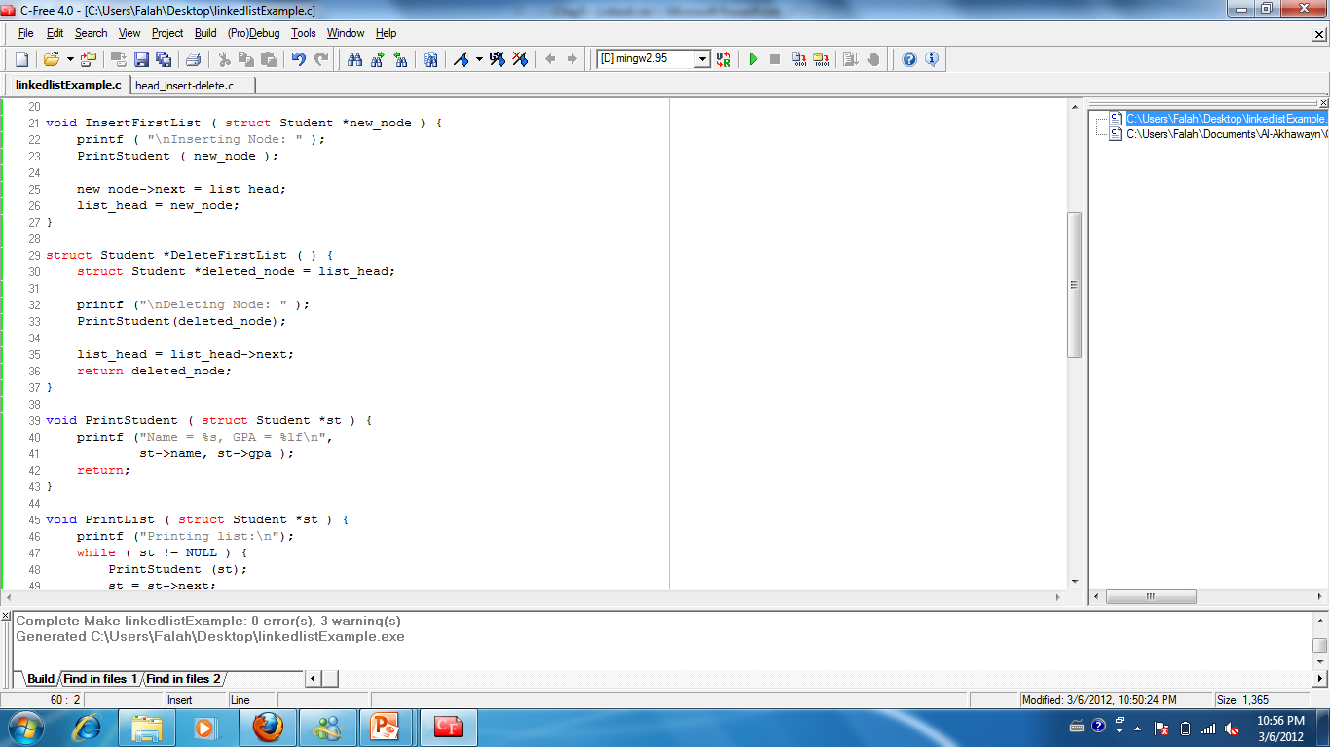
Example: Inserting and Deleting at the beginning of LL
Print Student Info

Slide 21
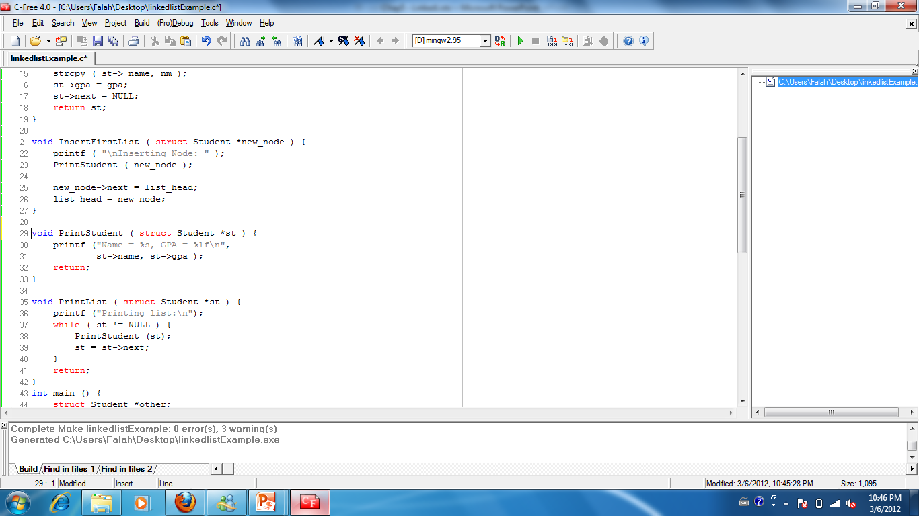
Example: Inserting and Deleting at the beginning of LL
Insert a new student Node at the beginning od the LL

Slide 22

Example: Inserting and Deleting at the beginning of LL
Delete the first student Node from the LL

Slide 23
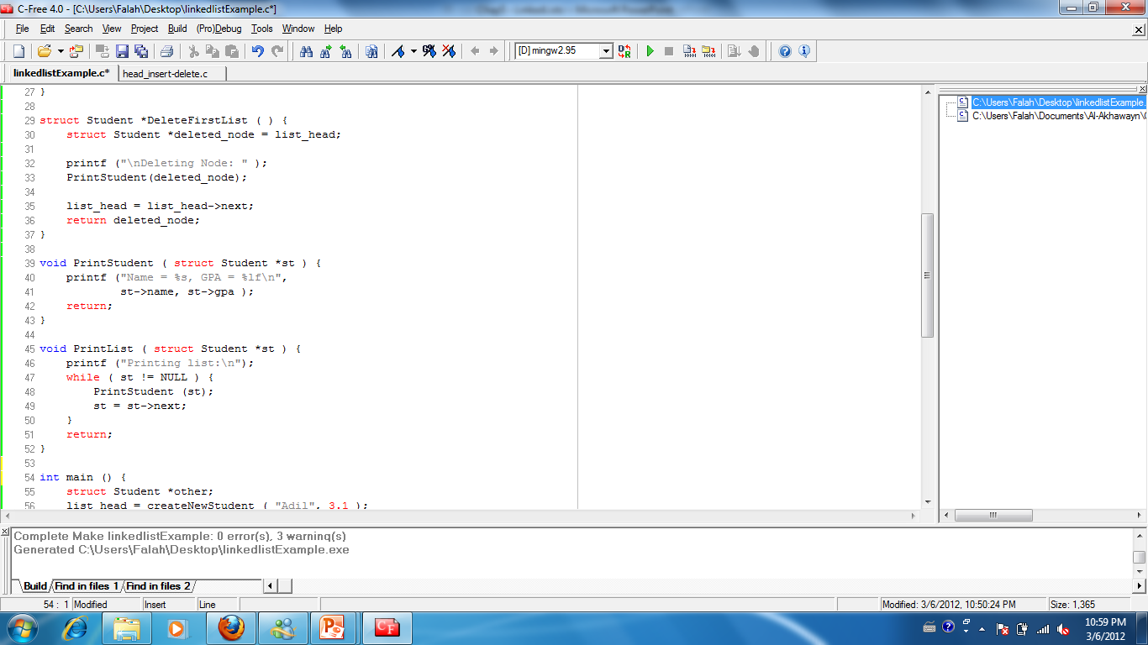
Example: Inserting and Deleting at the beginning of LL
Print the linked list

Slide 24
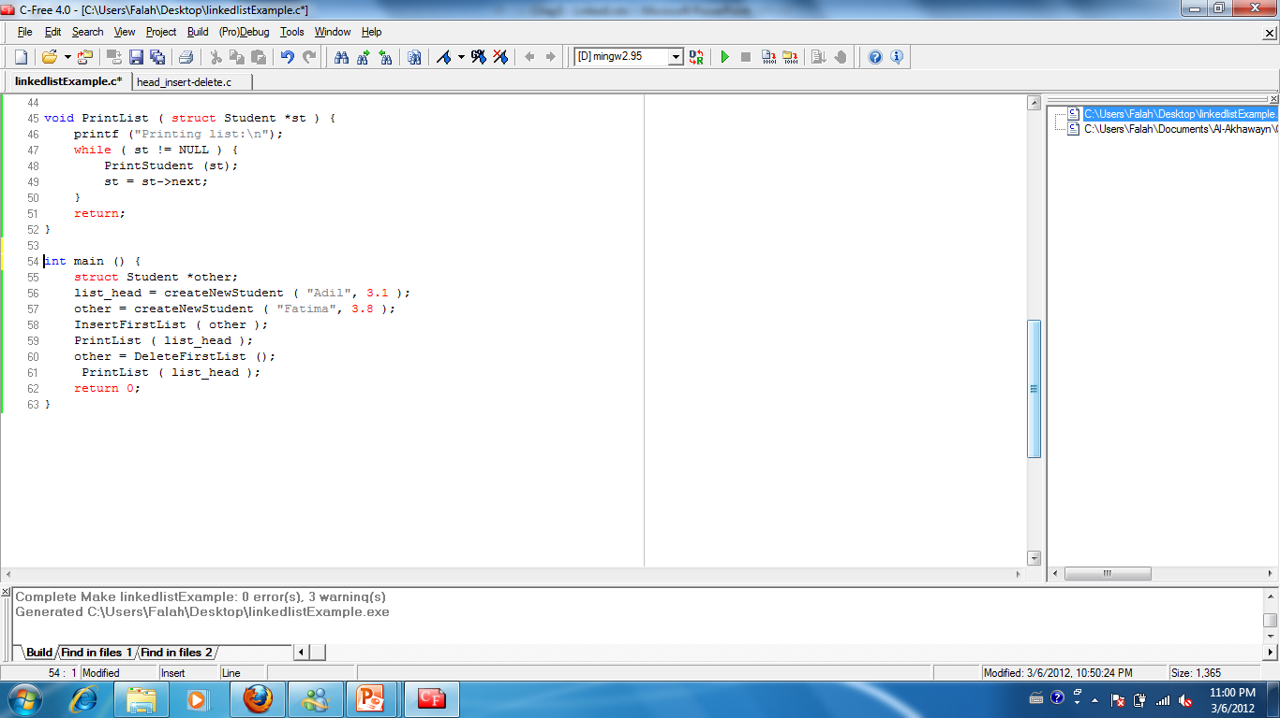
Example: Inserting and Deleting at the beginning of LL
Main function

Slide 25
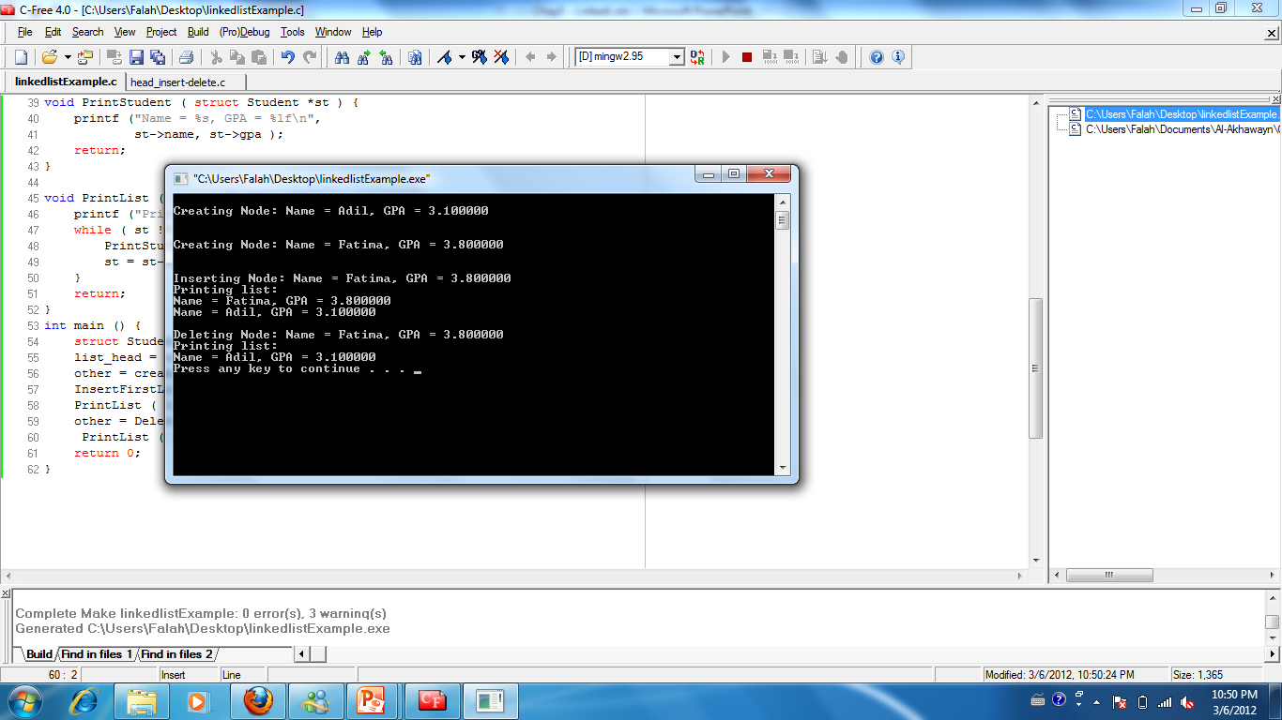
Example: Inserting and Deleting at the beginning of LL
Execution

Slide 26
Searching in Linked List
Write a function that, given a list and a target value (called key) to search for in a list (e.g. an integer stored in the info part of a node) looks for a node containing that value.
If it finds it, it returns the pointer to the containing node.
If it doesn’t find it, it returns NULL.

Slide 27
Searching in Linked List General Formulation
Node *Search ( Node *head, value_t key ) {
Node *w = head; while ( w != NULL && w->info not-equal key ) w = w->next;
return w;
}

Slide 28
Traversing a Linked List
How can we asses the approach of creating a linkedlist?
One simple way to do so is to traverse the list and print the data in each node.
void TraverseList (Node *head)
Algorithm:
1. Set pointer to the first node in the list
2. While (not end of list)
2.1 process node (current node)
2.2 move to next

Slide 29
Example of List Traversal
Function PrintList in earlier example does a list traversal
void PrintList ( Student *st ) {
printf ("Printing list:\n");
while ( st != NULL ) {
PrintStudent (st); // Prints student info
st = st->next;
}
}

Slide 30
TraverseList: General Code
void TraverseList (Node *head)
{
Node *walker = head;
while (walker != NULL) {
process the information on the node
walker = walker->next;
}
}
Note the common loop structure:
while ( pointer != NULL) { … pointer = pointer->next ; }

Slide 31
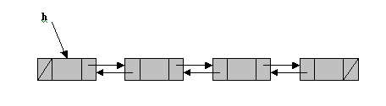
Special cases: Doubly Linked Lists
Besides data, every node contains 2 pointers:
one pointing to the previous node in the list
the other pointing to the next node

Slide 32
Alternative Definitions
Focus on named type Node (a struct type):
typedef struct node Node;
struct node {
char name[20];
double gpa;
Node *next, *prev;
};
Focus on named type NodePtr (a pointer type):
typedef struct node *NodePtr;
struct node {
char name[20];
double gpa;
NodePtr next, prev;
};

Slide 33
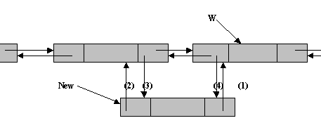
Doubly Linked Lists: Insertion
(1) New -> next = W
(2) New -> prev = W -> prev
(3) New -> prev -> next = New
(4) W -> prev = New
Inserting at the head/tail are special cases (unless we have header and tailer cells).
P
prev
next

Slide 34
Doubly Linked Lists : Deletion
We visualize remove(p), where p == last()
p
A
B
C
D
A
B
C
p
D
A
B
C

Slide 35
Doubly Linked Lists Deletion
Deleting a node requires that we logically remove the node from the list by changing various links and then physically deleting the node from the list.
Any node in the list can be deleted. Note that if the only node in the list is to be deleted, an empty list will result. In this case the head pointer will be set to NULL

Slide 36
Doubly Linked Lists Deletion
To logically delete a node:
First locate the node itself.
Change the predecessor’s and succesor’s link fields to point each other.
Recycle the node using the free() function.

Slide 37
Special cases: Circular list
The tail of the list points to the head; otherwise, no change.
Still keep a head pointer, no tail pointer
Singly or doubly linked list
Advantage:
Uniform insertions and deletions without header or tailer cells.

